Slide 1
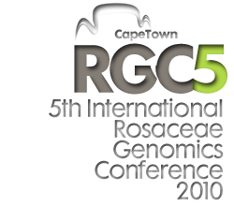
14 -17 November 2010
Wallenberg Centre,
S TIAS, Stellenbosch
www.rgc5.co.za
reventer@netactive.co.za
Greetings
The Agricultural Research Council of South Africa invites you to attend the 5th International Rosaceae Genomics Conference (RGC5), to be held at the Wallenberg Centre, STIAS, in Stellenbosch from 14 – 17 November 2010.
The release during 2010 of the sequences of the apple, peach and strawberry genomes will mark the transition of Rosaceae genomics, genetics and breeding into a new era of science and technology. As a result many problems become tractable to new forms of analysis. RGC5 occurs at the time when these genome sequences will have entered the public domain, and this creates the opportunity for a most exciting and informative conference. At the same time, the conference is themed, “The Big Five”, and it is hoped that the work on pear and rose will also play an important role in the conference.
Of course for those visiting South Africa for the first time, there is a wide range of attractions to experience, and for those returning there will be many familiar people and places, and we hope new ones as well.
We are looking forward to your participation
Jasper Rees Head: Biotechnology Platform Agricultural Research Council
South Africa
Standard Registration:
1 August - 22 October
Late Registration:
>23 October
Abstract submission:
Oral :due urgently
Poster :30 September

